Slide 1
Automatic Extra Axial CerebroSpinal Fluid (Auto EACSF)
Tutorial on how to use the tool
Author : Arthur Le Maout
Contact : alemaout@mail.unc.edu

Slide 2
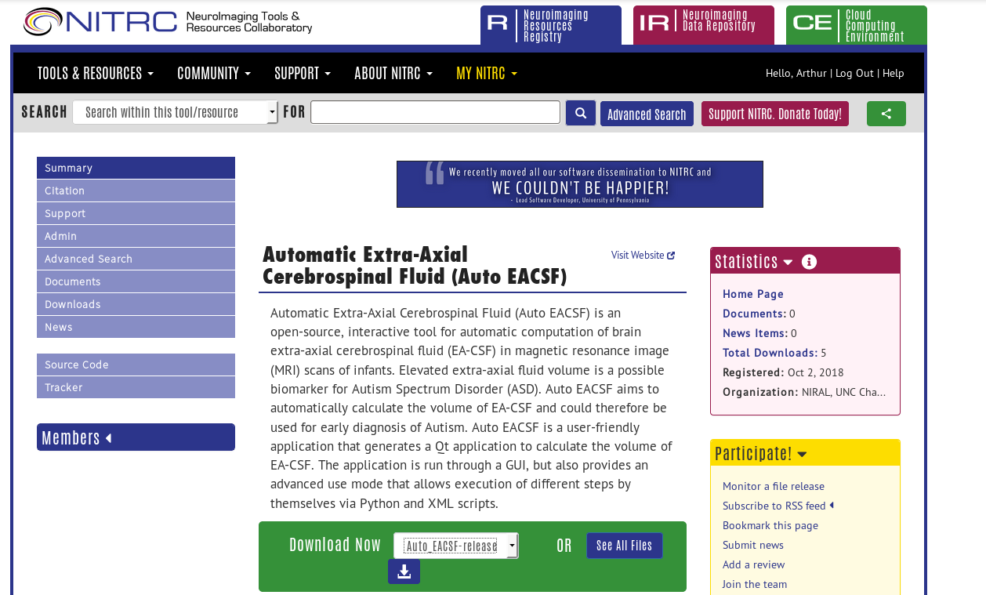
How to get Auto EACSF
Image below : the Auto_EACSF NITRC page
Download available on NITRC :
https://www.nitrc.org/projects/auto_eacsf/
Be sure to get the latest version.
After downloading the zip file, extract it in your working folder then follow the instructions in the README.txt file.
Click here to download

Slide 3
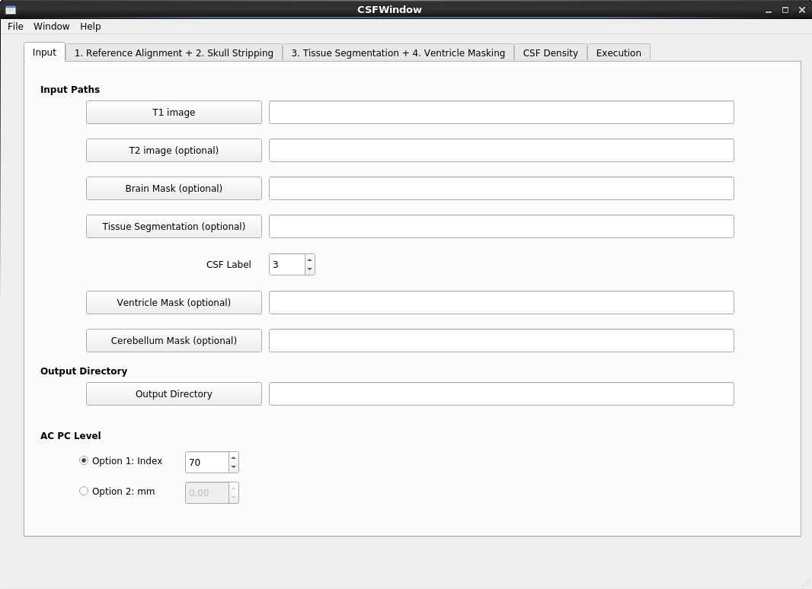
General overview
Image below : Auto EACSF window at execution
Purpose of the software :
From T1 only or T1 and T2 MRI images of the brain, the tool extracts the area that corresponds to the external cerebrospinal fluid.
For faster computation you can provide a brain segmentation, a brain mask and a ventricle mask, that will be automatically generated if not provided.
Click here to load T1 image
The file’s path will appear here

Slide 4
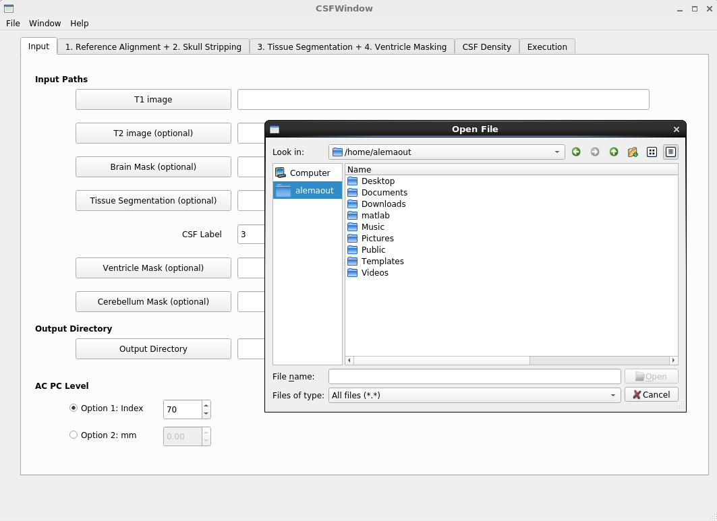
Step 1: Provide the input data
Image below : the input tab after clicking on one of the inputs buttons
Each buttons from T1 image to Output Directory allows you to navigate throw your computer’s folder to select the corresponding files or folder. Only T1 image is strictly required.
If not Output Directory is given, the outputs will be produce in the execution folder.

Slide 5
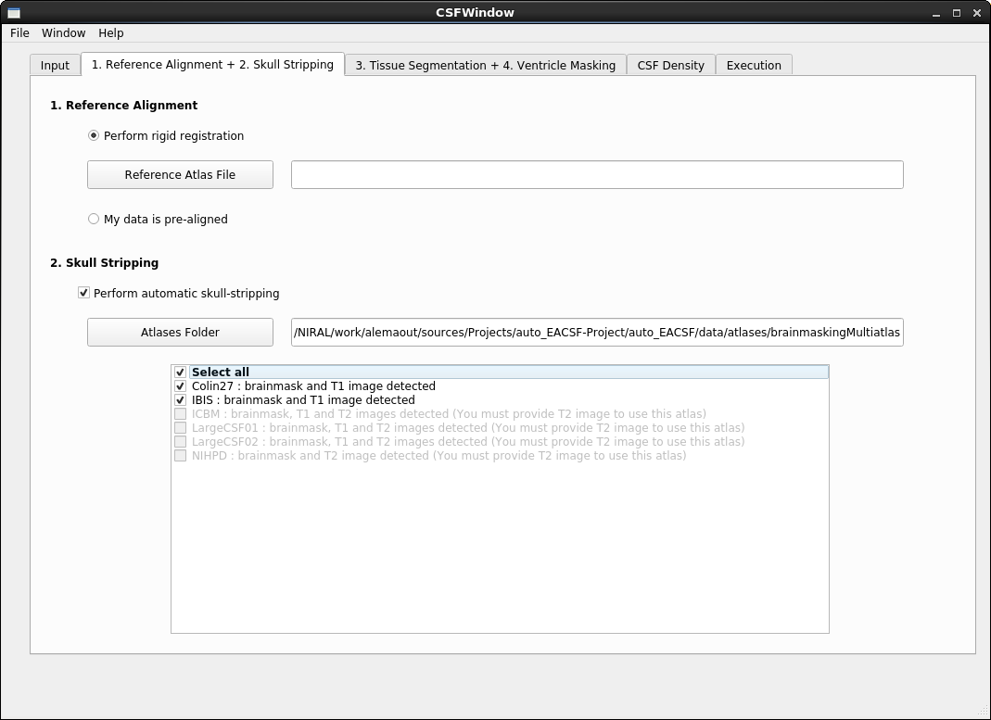
Step 2: Reference alignment and skull stripping parameters
Image below : reference alignment and skull stripping tab
Select this option to perform the rigid registration
If your data is not aligned, the tool can put it into a reference space if you provide a reference atlas file.
If you did not provide a brain mask, you can chose to perform automatic skull stripping by checking the checkbox and providing an atlas folder*. You can then select the atlases you want to use from your folder.
Select this option to create a brain mask if you can’t provide one
* You must respect the file name convention : [atlas_name]_brainmask.nrrd ; [atlas_name]_T1.nrrd ; [atlas_name]_T2.nrrd

Slide 6
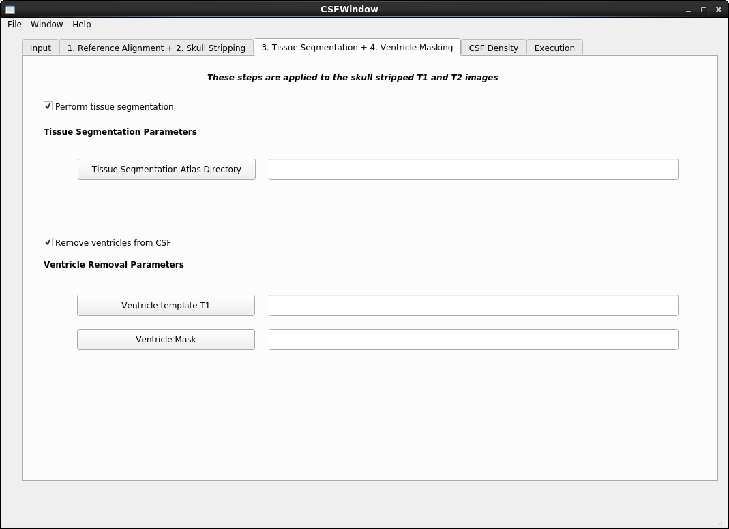
Step 3: Tissue segmentation and ventricle masking
Image below : tissue segmentation and ventricle masking tab
Select this option to create the tissue segmentation of the brain if you didn’t provide one
If you did not provide a tissue segmentation it must be done with the tool providing an atlas directory.
If you wish to remove the ventricle from the CSF extraction, this will be done by checking the checkbox and providing a specific ventricle mask on the first tab and/or a template mask with the corresponding template T1.
Select this option to remove the ventricles

Slide 7
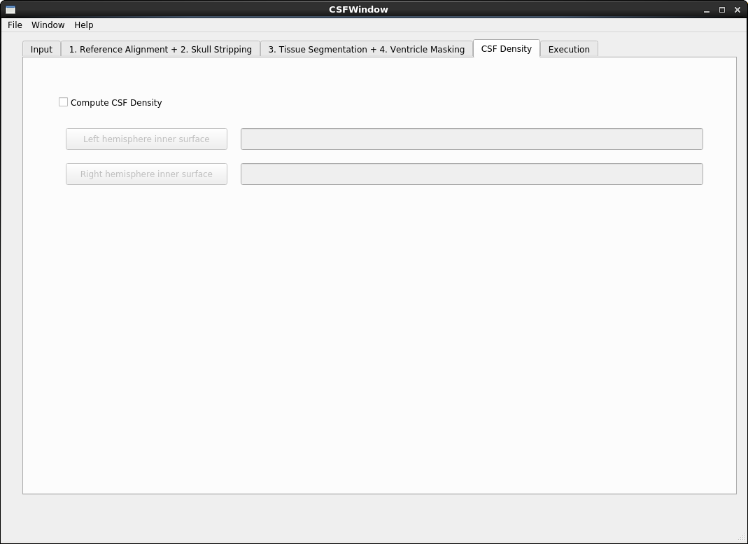
Optional step: CSF Density
Image below : CSF density tab
If you provide in this tab the inner surfaces for both hemisphere, the tool can calculate the local density of external CSF in the brain.

Slide 8
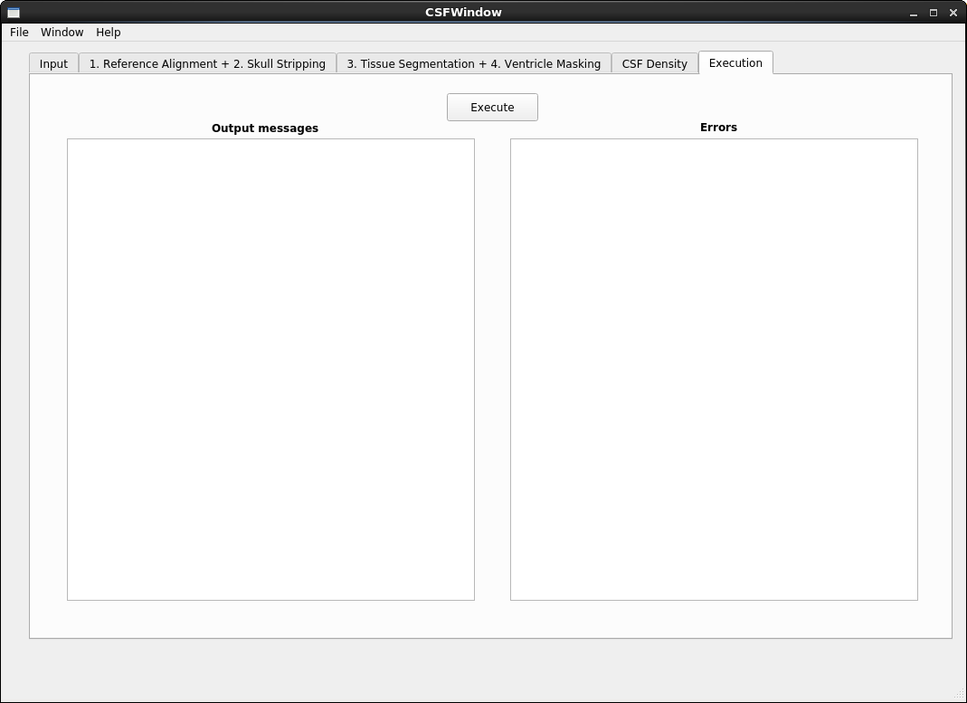
Final step: execution
Image below : Execution tab
You can now click the execution button to start the process. You can read and identify the current state of the pipeline through the output messages panel and potential errors through the errors panel.
Click here to start the pipeline

Slide 9
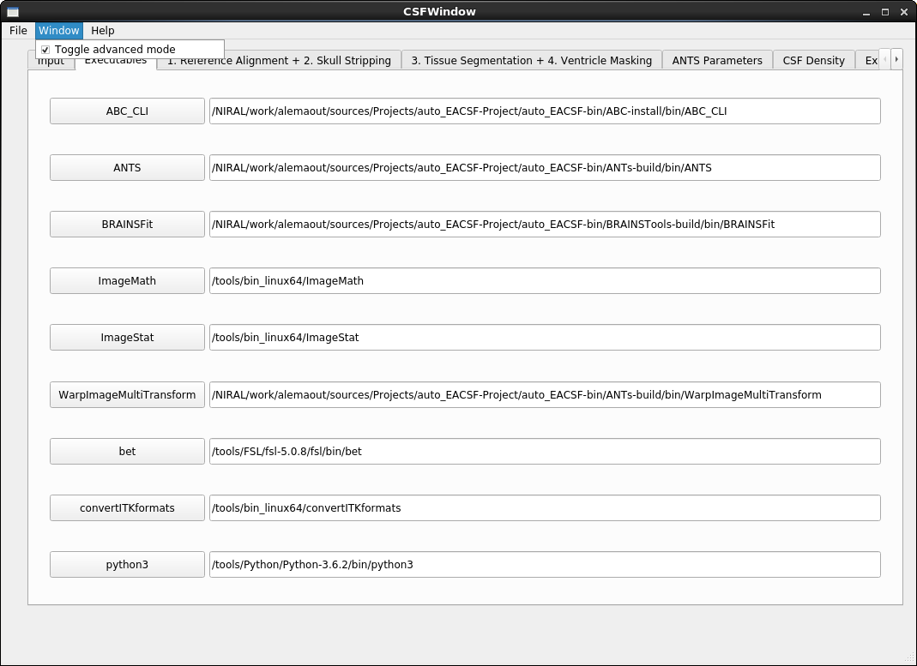
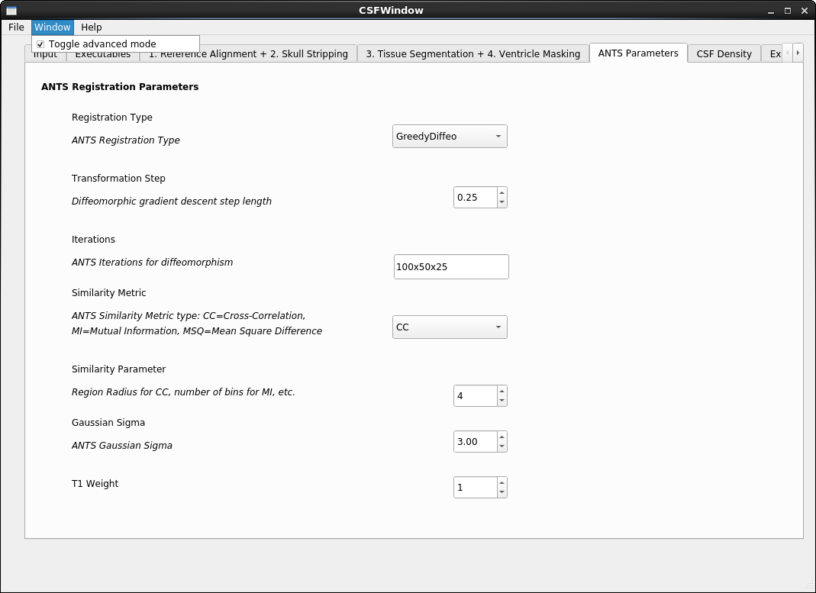
Advanced display mode
Images below : the two new tabs of the advanced display
If you click window > Toggle advanced mode, two new tabs will appear.
The Executables tab allows you to set manually the paths to the external tools used by Auto EACSF.
The ANTS Parameters allows you to set the different parameters used each time Auto EACSF will use the ANTS tool.

Slide 10
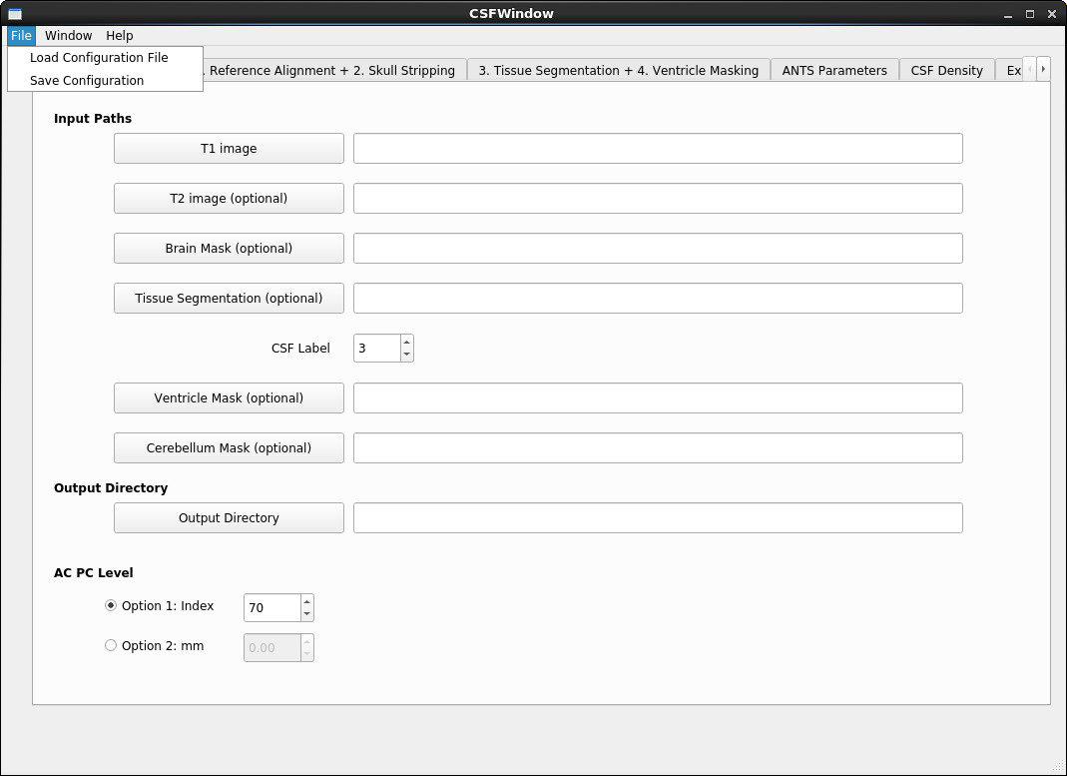
Saving and loading configurations
Image below : the file menu
Auto EACSF allows you to save your configuration (paths to the files and different parameters that you set for one execution) in JSON files. You can then load them again to reproduce the execution.
To save your settings or load saved ones, use the File menu on the top left of the window.

